Slide 1
DSC3013 Intro. to Social
Media Analytics (Lec. 3)
Hao PENG
Department of Data Science
City University of Hong Kong
https://haoopeng.github.io/

Slide 2
Learning Objectives
By the end of this lecture, you will be able to:
- Distinguish between classification and regression tasks
- Explain logistic and OLS regression in plain language
- Identify when to use count models like Negative Binomial Reg.
- Contrast and interpret common evaluation metrics
- Apply predictive models to social media research questions
- Critically evaluate model performance and limitations

Slide 3
Agenda
1. What is predictive analysis (vs. interpretive analysis)
2. Classification models (logistic reg., Naïve Bayes)
3. Regression models (OLS, Ridge, Negative Binomial)
4. Model evaluation metrics
5. Applications in social media analytics
6. In-class exercises
7. Python tutorial
  Scikit-learn
  Predicting news coverage of papers

Slide 4
What Is Predictive Modeling?
Definition:
The use of statistical or machine learning techniques to predict an outcome (often called dependent variable) from one or more input variables (often referred to as features or predictors).
Two broad families:
- Classification: Predict a category (e.g., spam vs. not spam)
- Regression: Predict a numeric value (e.g., number of shares)
Goal: Focus on prediction performance and generalization to new (unseen) data. Less so on explanation and interpretation.

Slide 5
Prediction vs. Explanation
Goal
Focus
Typical Question
Explanation
Why does X happen?
What drives engagement?
Prediction
Will it happen?
Will this post go viral?
- Both matter in social media analytics
Predictive models prioritize out-of-sample accuracy (DSC3013)
Explanatory models prioritize correlation, causality (DSC2005)
- Different terminologies
Explanation: coefficients, p-value; fit to all data (Statsmodels)
Prediction: performance; train/test, k-fold CV (Scikit-learn)

Slide 6
Classification vs. Regression
Task
Outcome Type
Example
Classification
Categorical
What’s user’s personality?
Regression
Continuous
What’s the toxicity level of posts?
Count regression
Non-negative integers
Number of retweets / likes
Binary classification
Two classes
Misinformation vs. factual
Notes:
Will the user upgrade to Premium?

Slide 7
Logistic Regression - Intuition
Definition:
A statistical model that predicts the probability of a binary outcome (0 or 1) using a logistic (S-shaped) function.
Why not linear regression for binary outcomes?
- Linear models can predict probabilities outside 0-1
- Logistic regression keeps predictions in [0, 1]
Output: Probability between 0 and 1, converted to class using a pre-defined threshold (usually 0.5; not always).

Slide 8
Logistic Regression
Logit equation:
log(p / (1 - p)) = b₀ + b₁X₁ + b₂X₂ + ... + b_{k}X_{k}
p = probability of the outcome
X = predictor variables
b = coefficients (log-odds change for a one-unit increase in X)
More on interpretation of logit coefficients in DSC2005!
(odds ratio, relative increase in odds of success)
This course focuses on prediction performance.
Notes:
The new odds does not increase in a constant speed, but the log odds does.

Slide 9
Logistic Regression - Example
Research question:
Will a tweet be retweeted more than 100 times?
Predictors:
- Hashtag count
- Sentiment score
- Follower count of user
- Contains image (yes/no)
Outcome: 1 = high retweet, 0 = low retweet

Slide 10
Other Classification Models
- Naive Bayes: Fast, works well for text classification
- Decision Trees: Interpretable, handle nonlinearity
- Random Forest: Ensemble of trees, high accuracy
- Support Vector Machines: Good for high-dimensional data
- Neural Networks: Powerful but data-hungry
We focus on Logistic Regression and Naïve Bayes because they are interpretable and widely used in social science.

Slide 11
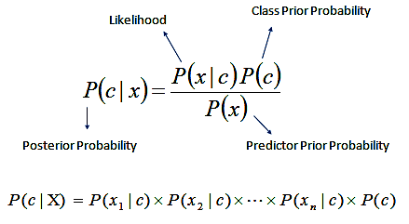
Naïve Bayes classifier
The Naïve Bayes classifier is a simple probabilistic classifier which is based on Bayes theorem but with strong assumptions regarding independence.
It is popular in email filtering, spam detection, document categorization.
Fast, efficient (time and space), scalable, easy to understand.
Prediction:
https://towardsdatascience.com/introduction-to-na%C3%AFve-bayes-classifier-fa59e3e24aaf
https://afit-r.github.io/naive_bayes

Slide 12
Naive Bayes - Example
Post
Clickbait
Caps
URL
Label
1
Yes
Yes
Yes
Fake
2
Yes
Yes
No
Fake
3
Yes
No
Yes
Fake
4
No
Yes
Yes
Fake
5
Yes
No
No
Fake
6
No
No
Yes
Real
7
No
No
No
Real
8
No
No
Yes
Real
9
No
Yes
No
Real
10
No
No
No
Real
Priors:
Conditional probabilities (smoothed):
P(Fake) = 5/10 = 0.50
P(Real) = 5/10 = 0.50
P(Clickbait=Yes | Fake) = 0.714 P(Clickbait=Yes | Real) = 0.143
P(Caps=Yes | Fake) = 0.571 P(Caps=Yes | Real) = 0.286
P(URL=No | Fake) = 0.429 P(URL=No | Real) = 0.429

Slide 13
Naive Bayes - Classifying a New Post
New post: Clickbait = Yes | Caps = Yes | URL = No
Smoothed conditional probabilities (likelihoods):
Feature
Value
P(v | Fake)
P(v | Real)
Clickbait
Yes
0.714
0.143
Caps
Yes
0.571
0.286
URL
No
0.429
0.429
Posterior scores (prior x likelihoods):
Score(Fake) = 0.5 x 0.714 x 0.571 x 0.429 = 0.0875
Score(Real) = 0.5 x 0.143 x 0.286 x 0.429 = 0.0088
Normalize to probabilities:
P(Fake | X) = 0.0875 / 0.0963 = 0.909
P(Real | X) = 0.0088 / 0.0963 = 0.091
Prediction: Fake

Slide 14
Laplace Smoothing
Why we need it:
In the raw training data, P(Clickbait=Yes | Real) = 0/5 = 0. A single zero makes the entire product zero, so the model can never classify such a post as Real. Smoothing avoids this.
Laplace smoothing formula (“add 1 trick”):
P(value | class) = (count + 1) / (class count + k)
- count = number of times value appears within the class
- class count = total number of samples in the class
- k = number of distinct values the feature can take (2 for binary)
Where:
Worked example (Clickbait = Yes | Real):
Raw count: 0 of 5 Real posts have clickbait
Smoothed: (0 + 1) / (5 + 2) = 1 / 7 = 0.143
Similarly, for (URL = No | Fake): (2 + 1) / (5 + 2) = 3 / 7 = 0.429
Notes:
Just image there is an extra datapoint added for Real group with Clickbait = Yes.
Then, to be fair, we need to also add an extra datapoint for Real group with Clickbait = No.

Slide 15
OLS Regression - Intuition
Definition:
Ordinary Least Squares (OLS) regression predicts a continuous outcome by finding the line that minimizes the sum of squared errors.
Equation:
Y = b₀ + b₁X₁ + b₂X₂ + ... + b_{k}X_{k} + e
Y = continuous outcome
b = coefficients
e = error term

Slide 16
OLS Regression - Assumptions
- Linearity between predictors and outcome
- Normal distribution of DV
- No severe multicollinearity
Strengths: easy to understand, highly interpretable.
Violations: biased coefficients, unreliable inference.

Slide 17
OLS Regression - Example
Research question:
How to predict the engagement score of each post?
Predictors:
- Word count
- User account age
- Number of hashtags
- Num. of day posted
Outcome: Engagement score (continuous, 0-100)
What if predictors are too many (e.g., thousands of n-grams)?
Notes:
How does post length affect engagement score?
(Focus on model coeff)

Slide 18
Ridge Regression Equation
OLS objective (for comparison):
minimize sum( y_{i} - y_hat_{i} )²
Ridge objective:
minimize sum( y_{i} - y_hat_{i} )² + lambda * sum( b_{j} )²
Key notes:
- lambda controls penalty strength
- Predictors must be standardized before fitting
- lambda = 0 reduces to OLS
- lambda -> infinity shrinks all coefficients toward zero

Slide 19
Ridge Regression vs. OLS
Why ridge reg. helps when predictors are many & correlated?
Key Benefits of Ridge:
- Handles multicollinearity: shrinks correlated coefficients for stability
- Reduces overfitting: constrains coefficient size, improves generalization
- Improves out-of-sample accuracy: trades bias for lower variance
- Single tuning parameter (lambda) chosen by cross-validation
- Works when p > n: can estimate when predictors outnumber observations
Dimension
OLS
Ridge
Multicollinearity
Unstable
Stable, shrunken
Overfitting risk
High
Reduced
p > n case
Cannot estimate
Can estimate

Slide 20
Ridge Regression - Example
Research question:
How well can linguistic features predict users’ empathy level?
Predictors based on all posts of each FB user:
- Unigrams (V = 10K)
- Bigrams (V = 50K)
- Trigrams (V = 30K)
- LDA topics (N = 1500)
- Word embeddings (300 dimensions)
Outcome: empathy score (continuous, 1-10)
N = 2,405 FB users who took a survey questionnaire
Notes:
How does post length affect engagement score?
(Focus on model coeff)

Slide 21

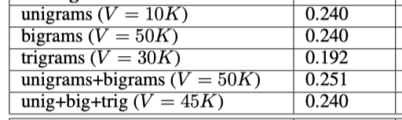
Predicting Empathy with Ridge
Outcome: empathy score (continuous, 1-10)
N = 2,405 FB users who took a survey questionnaire
Feature set
R²
Notes:
How does post length affect engagement score?
(Focus on model coeff)

Slide 22
Count DV Needs Special Models
Social media outcomes are often count data:
- Number of likes
- Number of retweets
- Number of comments
- Number of followers gained
Issues with OLS for count DV:
- Predicts negative values (impossible for count DV)
- Assumes constant variance (counts often have variance > mean)

Slide 23
Poisson Regression
Definition:
A generalized linear model for predicting count outcome variables. However, it assumes that mean = variance.
Equation:
log(Y) = b₀ + b₁X₁ + b₂X₂ + ... + b_{k}X_{k} + e
Y = expected count (non-negative)
Limitation: Real social media data is often overdispersed with a long tail distribution (variance > mean).

Slide 24
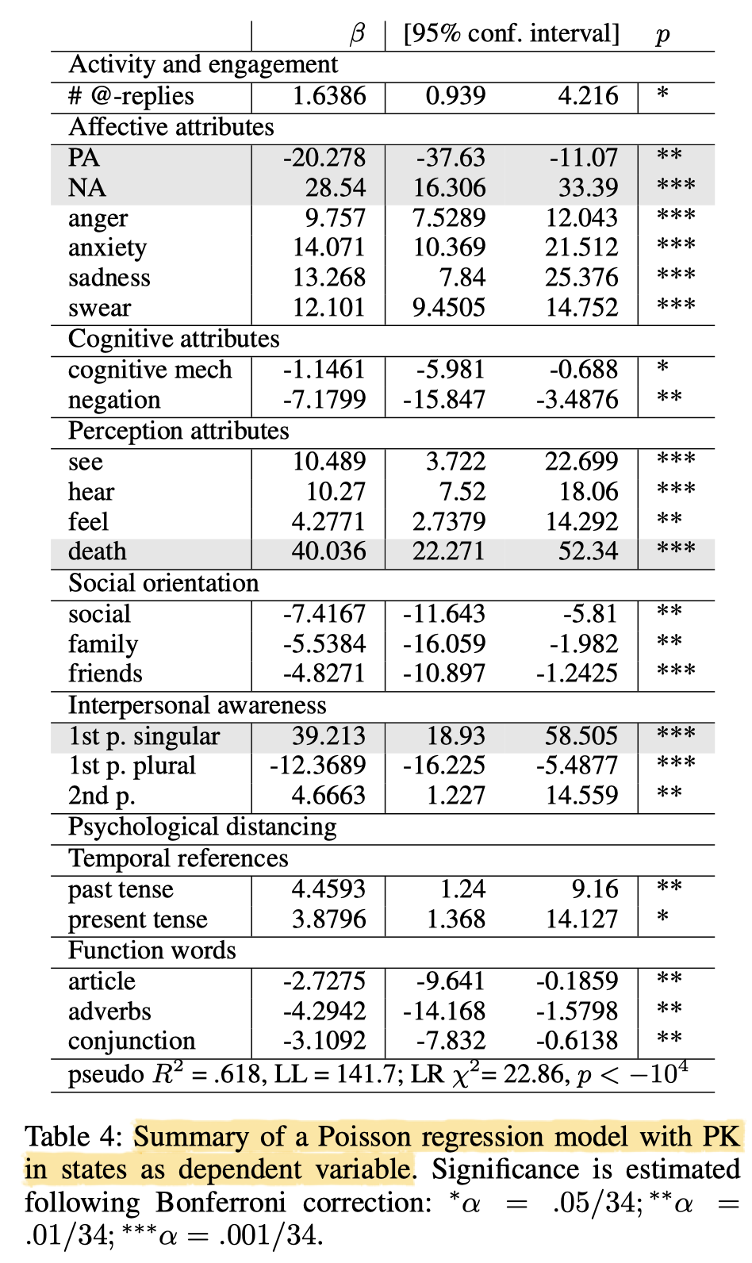

Policy killings in BLM
Predict num. of killings per US state using the Poisson regression model.
Performance: psudo-R² = 0.618

Slide 25
Negative Binomial Regression
Definition:
An extension of Poisson regression that accounts for overdispersion of the outcome variable by including an extra dispersion parameter.
When to use:
- Count outcome (DV)
- [Use zero-inflated NBR for DV with excessive zeros]
- Variance substantially greater than the mean
Why it matters: Poisson underestimates standard errors when overdispersion is present, leading to overly optimistic p-value, false statistical significance, and weaker performance.

Slide 26
Negative Binomial - Example
Research question:
What predicts the number of likes an IG post receives?
Predictors:
- Hashtag count
- Follower count
- Account gender
- Contains pet (yes/no)
Outcome: Like count (non-negative integer, overdispersed)

Slide 27
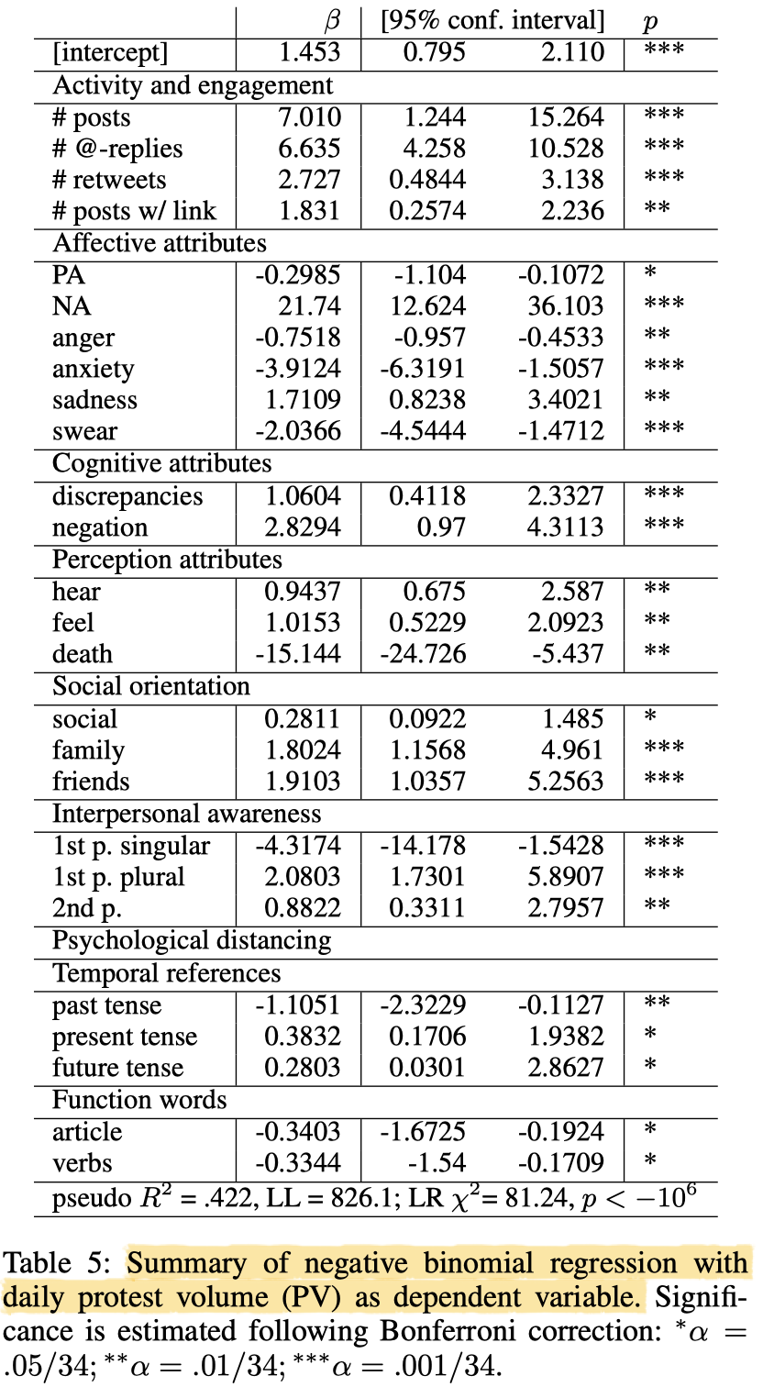
Protest volume in BLM
Predict total num. of participants in all protests per day in each state using the NB regression model.
Performance: psudo-R² = 0.422

Slide 28
Why Evaluation Matters
- A model that fits the training data well may fail on new data
- Overfitting: Memorizing noise instead of learning patterns
- Underfitting: Model too simple to capture statistical regularity
Evaluation tells you how well your model generalizes
Key idea: Evaluation on data the model has not seen.

Slide 29
Netflix challenge
Netflix offers $1M USD cash prize for a better recommendation algorithm in October 2006.
Training data:
100M ratings of 17,770 movies by 480K users
6 years of data: 2000-2005
Test data:
    Last few movie ratings of each user (2.8M)
    Evaluation via root mean squared error (RMSE)
    Netflix Cinematch RMSE: 0.9514 (baseline)
Competition:
$1M grand prize for 10% improvement
If 10% not met, $50K annual “Progress Prize” for best improvement

Slide 30
Train / Test Split
- Split data into training set (e.g., 70-80%) and test set (20-30%)
- Train the model on training data
- Evaluate on test data
- Optional: cross-validation for more robust estimates (k-fold)
[Note: CV can also be used for fine-tuning parameters]
Rule of thumb: Never evaluate on the same training data.

Slide 31
Confusion Matrix (Classification)
Predicted Positive
Predicted Negative
Actual Positive
True Positive (TP)
False Negative (FN)
Actual Negative
False Positive (FP)
True Negative (TN)
Everything in classification evaluation metrics builds on these four counts. Confusion matrix can really confuse people ;)

Slide 32
Accuracy
Accuracy = (TP + TN) / (TP + TN + FP + FN)
- Proportion of correct predictions
- Problem: Misleading when classes are (super) imbalanced
Example: If 95% of posts are not spam, a model predicting 'not spam' always gets 95% accuracy but is useless.

Slide 33
Precision-Recall (focus on minority class)
Precision = TP / (TP + FP)
Recall = TP / (TP + FN)
Precision: Of the posts predicted positive, how many actually were?
Recall: Of the actual positive posts, how many did we catch?
Trade-off:
- High precision = few false alarms
- High recall = few missed cases
In principle, you can always achieve a high precision using a high threshold (high confidence), but recall will be very low.

Slide 34
F1 Score
F1 = 2 x (Precision x Recall) / (Precision + Recall)
- Harmonic mean of precision and recall
- Useful when classes are imbalanced
- Balances both metrics in a single number
When to use:
Spam, misinformation detection, hate speech classification.

Slide 35
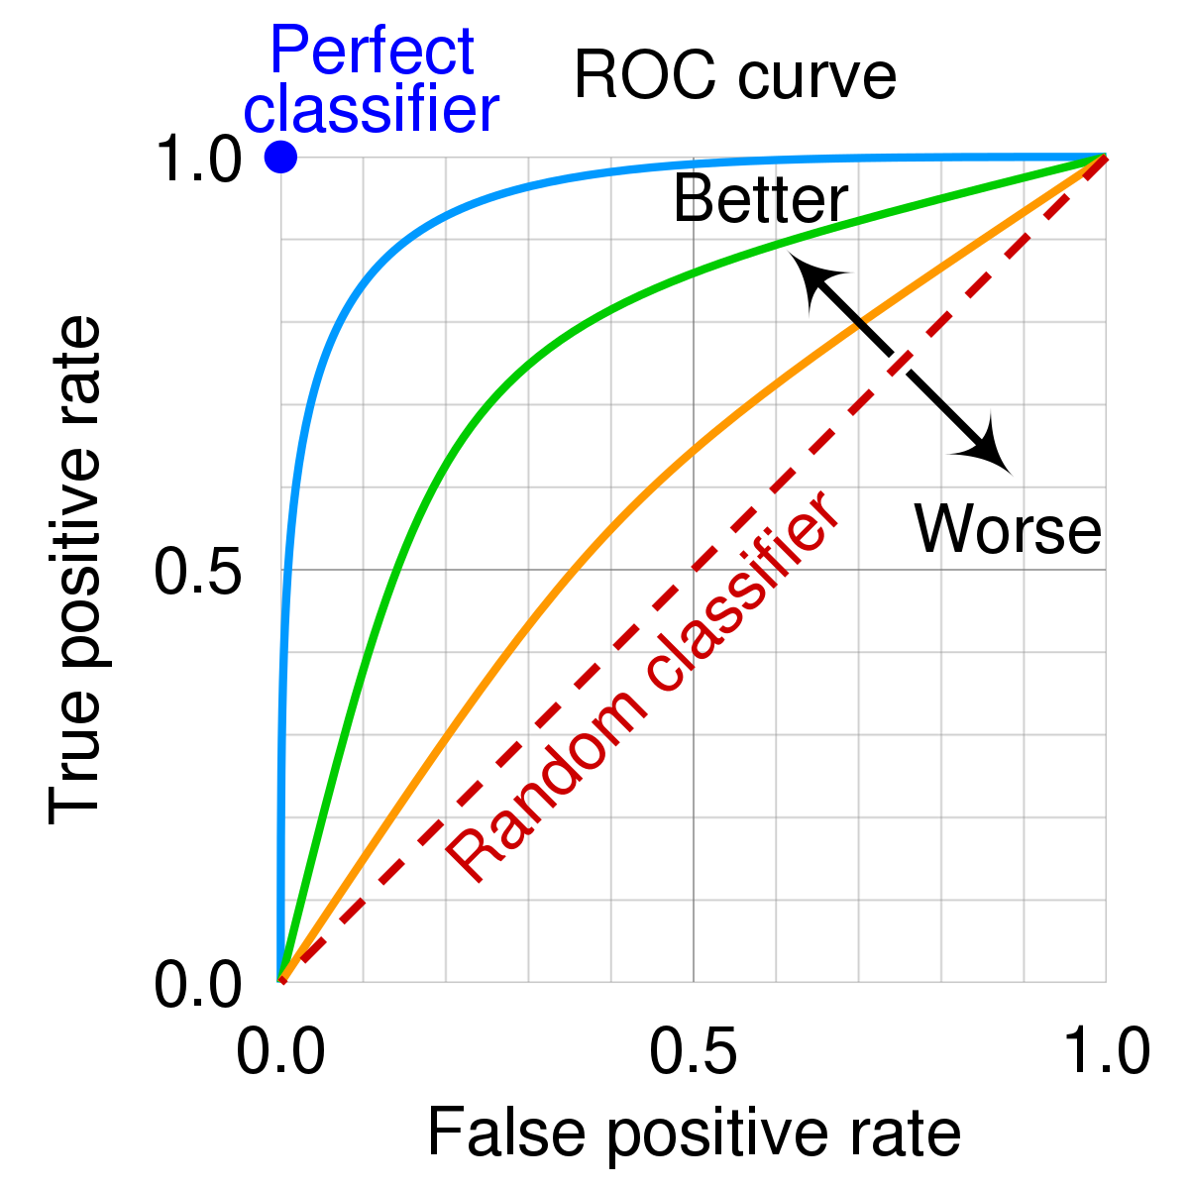
Summary metric: AUC-ROC
True positive rate = TP / (TP + FN)
False positive rate = FP / (FP + TN)
- ROC curve: Plots TPR and FPR at different thresholds
- AUC (Area Under Curve): Single number summarizing performance
Advantage: Threshold-independent evaluation
- 0.5 = no skill model
- 0.7-0.8 = acceptable
- 0.8-0.9 = good
- > 0.9 = excellent
Notes:
ROC curve balances two types of errors.
Summarize model performance over all thresholds.

Slide 36
Regression Metrics - RMSE & MAE
RMSE
MAE
Root Mean Squared Error - penalizes large errors more
Mean Absolute Error - easier to interpret and understand
Both: Lower is better.
Advantage: Units match the scale of outcome variable.

Slide 37
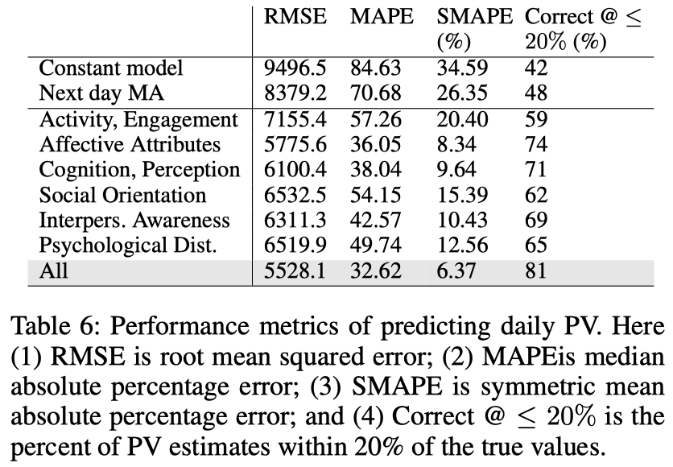
RMSE example
Predict daily protest volume using NB regression:
  Can use different variations of a metric
  Other metrics: Median Absolute Deviation

Slide 38
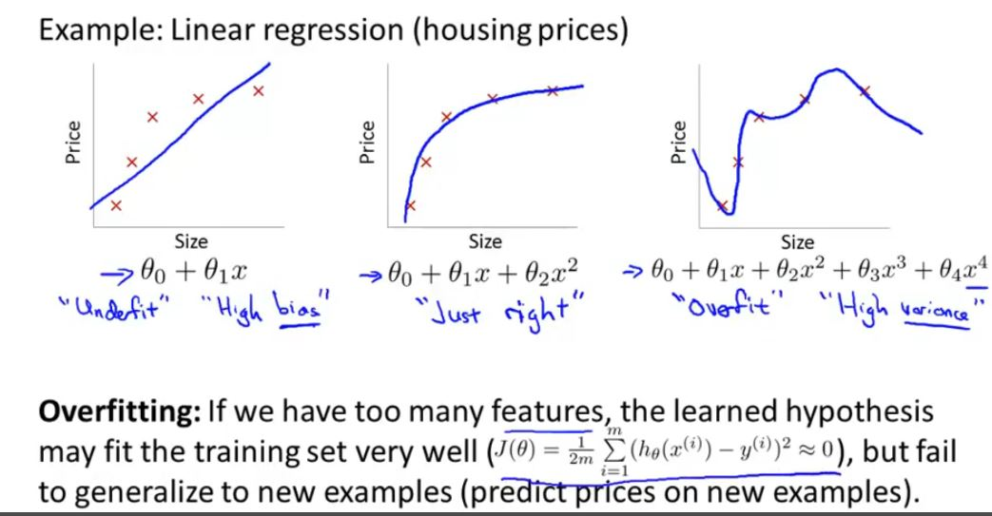
Regression Metrics - R-Squared
R-squared:
Proportion of variance in DV explained by the model
- Range: 0 to 1 (higher is better)
- Can be misleading with many predictors
https://medium.com/@jennifer.zzz/more-features-than-data-points-in-linear-regression-5bcabba6883e
Notes:
R² is a goodness-of-fit measure; but is not often used to compare different models.
In different fields, good R² values are vastly different. E.g., even with a great model, studies that try to predict human behaviors generally have R² less than 0.5.
- Why? People are just harder to predict than things like physical processes.

Slide 39
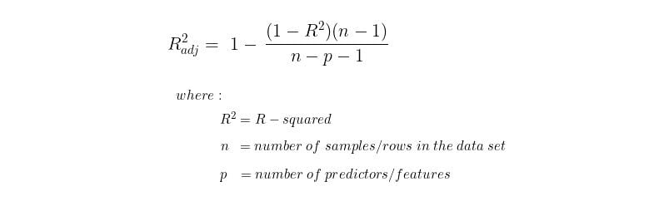
R² vs. Adjusted R²
R² always increases when more vars are added to the model.
Therefore, R² cannot be used for comparing whether one model is better than another. Adjusted R-squared imposes a higher penalty on a new variable and thus is a more reliable indicator of model performance.
https://builtin.com/data-science/adjusted-r-squared

Slide 40
Metrics for Count Models
Other commonly used criteria to judge model performance:
- Deviance: Measures model fit; lower is better
- AIC / BIC: Information criteria; balance fit and complexity
- Pseudo-R²: sometimes called “Likelihood ratio index”

Slide 41
Case 1 - Predicting Virality
Question: Will this post go viral (e.g., > 10,000 shares)?
Model: Logistic regression
Predictors:
- Sentiment
- Hashtags
- Media type (image, video, text)
- Author follower count
- Time of posting
Outcome: viral (1) vs. not viral (0)
Metric: Accuracy and AUC (if balanced)

Slide 42
Case 2 - Time-to-Peak Engagement
Prediction task: how many hours a hashtag takes to reach peak posting volume, using first-hour features only.
Model: OLS or Ridge | Outcome: num. of hours (continuous)
Predictors:
- Initial post volume (first hour)
- Number of unique accounts
- Average follower count (logged)
- Contains emotional language (0/1)
- Contains URL (0/1)
- Verified originator (0/1)
- Topic category (news, humor, activism)
- Hour of day first posted
Metrics: RMSE, MAE, (Adjusted) R-squared

Slide 43
Case 3 - Detecting Misinformation
Question: Is this post likely to contain misinformation?
Model: Naïve Bayes or Random Forest
Predictors:
- Source credibility
- Sentiment polarity
- Presence of URLs
- Language style
- Retweet network features
Outcome: misinformation (1) vs. factual (0)
Metric: Precision, recall, F1 (false negatives are costly)

Slide 44
Exercise 1 - Choosing the Right Model
Decide: classification, OLS, Ridge, or Negative Binomial?
1. Predicting whether a tweet contains hate speech
2. Predicting the number of comments on a FB post
3. Predicting a brand's sentiment score (continuous, -1 to 1)
4. Predicting whether a user will click an ad
5. Predicting the number of followers gained per week
Discuss in pairs for 5 minutes, then share.

Slide 45
Exercise 2 - Interpreting Results
Scenario: A logit model predicts whether a tweet will be retweeted > 100 times. Coefficient for 'contains image' = 0.85 (p < 0.001).
Questions:
- How would you interpret the coefficient in plain language?
- What is the odds ratio? Will it be greater than 1?
- If you changed the prediction threshold from 0.5 to 0.3, what would
happen to accuracy, precision, and recall?
- What metric would you use if missing a viral tweet is very costly?
Notes:
Odds ratio = exp(0.85) > 1

Slide 46
Offline Exercise
Discuss with Group members:
1. Pick a social media phenomenon (e.g., influencer marketing, political mobilization, brand crisis)
2. Formulate a prediction task / question
3. Choose a model (classification, OLS, Ridge, or NB)
4. List 4-5 predictors
5. Identify the best evaluation metric and justify it

Slide 47
Reflection Questions
1. When would you prefer interpretability over predictive accuracy?
2. How do you decide the classification threshold in practice?
3. Can a model be accurate but unethical? Give an example.
4. What are the risks of deploying predictive models on social media?
5. How would you explain a logistic regression to your grandma?

Slide 48
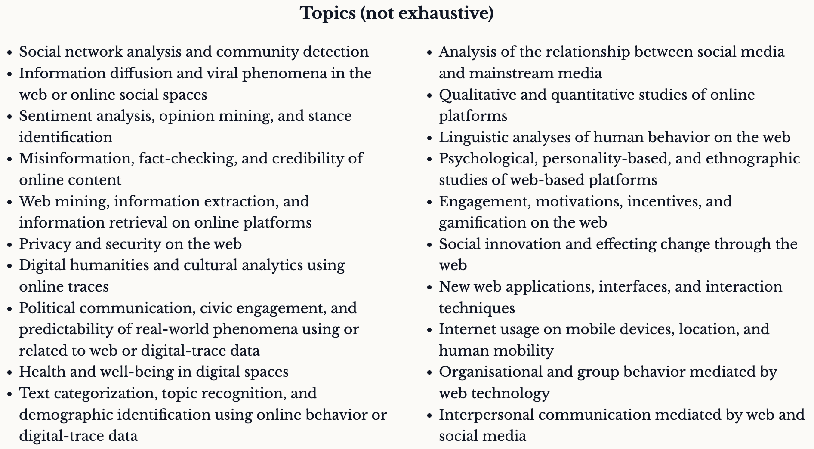
Course Notes
Brainstorm research questions for group projects
Consult ICWSM: https://www.icwsm.org/2027/

Slide 49
Logistic Regression (use for 2005)
Logit form:
log(p / (1 - p)) = b₀ + b₁X₁ + b₂X₂ + ... + b_{k}X_{k}
p = probability of the outcome
X = predictor variables
b = coefficients (log-odds change for a one-unit increase in X)
Odds (of success) means the term: p / (1-p)
log (odds₂) – log (odds₁) = b → odds₂ / odds₁ = exp(b)
This indicates that the odds ratio stays constant for each one-unit increase in X. We can also calculate the relative increase in odds of success as: (odds₂ - odds₁) / odds₁ = exp(b) - 1
Notes:
The new odds does not increase in a constant speed, but the log odds does.

Slide 50
Logistic Regression - Example
Research question:
Will a tweet be retweeted more than 100 times?
Predictors:
- Hashtag count
- Sentiment score
- Follower count of user
- Contains image (yes/no)
Outcome: 1 = high retweet, 0 = low retweet
Interpretation: A positive (> 0) coefficient means the predictor increases the odds of being highly retweeted.
In practice, you can also report odds ratio (OR) by exponentiating the coefficient, then you compare OR with 1 instead of 0. Why?

